Slide 1
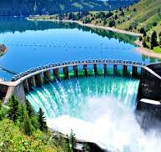
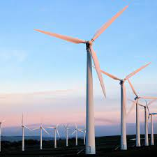
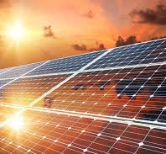
Patterns in Global Gross Domestic Product Relative to Energy Consumption
Brianna Palmisano
St. John's University
The Peter J. Tobin College of Business
Notes:
Hi I'm Bri Palmisano
This is my first conference as well as my first venture in in-depth economic writing.
I've just recently completed my Bachelors in Business at St. John's University
and I'm currently working on individual literature review on The Anthropogenic and Geo-Economic Impact of Energy Scarcity.

Slide 2
Overview
This paper examines the prominence of...
Renewable and nonrenewable resources in global energy consumption
The near-direct relationship that our current global energy-mix has with global levels of economic output.
Notes:
In this presentation I will touch on basic concepts of my writing, including...
The environmental impacts of implementing alternatives to burning fossil fuels and biomass or "clean” energy sources
The influence that energy sources have on decarbonization.
The near-direct relationship between rising levels of economic activity and energy consumption
The power that regulation and green policies have in our fight climate change
Degrowth in comparison to intensity management.

Slide 3
Previous Research
There has been a lot of previous research on the economics that motivate climate change, though none directly in-line with the objective of analyzing economic prosperity relative to our current energy- mix over the period of 1965 to 2022.
Nonrenewable resources dominate for at least half of all individual and world energy consumption.
Specifically, our anthropogenic processes via greenhouse gas emissions are the main cause of climate change.
Notes:
Its is no secret that The global state of energy scarcity is a result of overconsumption of natural resources.
The tragedy of the commons is a situation in which individuals act in their own interest in determining their consumption of a common resource.
This is the current fate of our energy scarcity.
With more economic growth comes a need for more energy, though this trend is stronger in some countries over others
Being varying energy intensity levels and means, this relationship is not entirely direct but near direct.
Because our means of energy production is currently majorly unsustainable it is thus a growing threat to our biosphere and leading motivator of anthropogenic activity.

Slide 4

Defining Resources
Renewable
Renewable resources can be defined as those that can replenish themselves following their usage for energy by humans, including biofuels, hydro-, wind, and solar power
Nonrenewable
Nonrenewable resources can be defined here as primary commodities that cannot be naturally replenished by any means, including fossil fuels such as nuclear, gas, oil, coal, and traditional biomass
Notes:
Here we define...
Nonrenewables as those that cannot be naturally replenished by any means,
inclusive of fossil fuels such as coal, crude oil, nuclear energy and lithium
AND
Renewables
as those that can replenish themselves following their usage for energy by humans, including hydro-, wind and solar power

Slide 5
Input Data
The Input Data used has been sourced from Our World in Data and The Federal Reserve Economic Data of St. Louis (FRED of St. Louis).
Our World in Data uses primary data from Energy Institute Statistical Review of World Energy for the global primary energy consumption in TWh, by source. The measurement used here is terawatt, or the unit of measurement for energy or the amount of electricity heat produced.
The FRED of St. Louis uses secondary data from the World Bank to calculate the global GDP, per capita.
Notes:
These improvements are indispensable to the gravity of our current climate threats.
Many economic growth theories ignore the unfavorable variables in measuring the success of these implementations, the role that energy consumption plays in economic prosperity and its hand in climate recovery.
The implementation of clean energy systems though dire, can still be considerably costly for less wealthy countries, regardless of these shifts in cost comparison.

Slide 6
Methodology Part I
This analysis uses time series research via Microsoft Excel.
The dataset used here is secondary, as the primary data had been calculated using the ‘substitution method’ in resource consumption, and the calculations required in finding GGDP.
Here we have a total of fifty-eight observations.
We will use graphical techniques including histograms, time series plots and scatterplots.
We will also use statistical techniques including descriptive statistics (for scalable variables), as well as correlation and regression statistical analysis.
Notes:
The main resources used in energy are fossil fuels, accounting for at least half of all individual and world consumption.
Without implementing alternative energy sources to fossil fuels countries will continue to lack sufficient accesses to energy that allows them to boost their GDP with a smaller carbon footprint.
If you look each of these bars from the color teal and left, shows the weight of fossil fuels in each country's energy consumption.
As you can see the pattern from one country to another does vary in context of total energy consumption of each country, and the country's consuming less energy are all more than 50% dominated by unsustainable means.

Slide 7
Methodology Part II
Listed below are the equations defining the functional specification (Eqn. 1), population regression equation (Eqn. 2) & sample regression equation (Eqn. 3)
Eqn. 1 GGDP = f(GCRR, GCNR, Years)
Eqn. 2 GGDP =α + βgcrr GCRR + βgcnr GCNR + βyear Year
Eqn. 3 GGDP = a + bgcrr GCRR + bgcnr GCNR + byear Year
Our dependent variable here is levels of global economic output, measured by GGDP per capita.
Our independent variables are the two categories of energy sources being consumed; renewable and nonrenewable resources, as well as Years, or the year the initial data was collected.
Notes:
Energy scarcity has put an immense strain on the global energy demand as well as on nations to provide their people and firms with power to drive economic success.
The economics of climate change thus vary amongst different countries, determinant of the level of accessibility to energy.
There are less-developed economies that are lacking in quality of life due to lack of access to energy or lack of production of energy in their countries.
While the largest economies have the highest contributions to greenhouse gas emissions, there are lesser economies with similar GHG emissions levels, though do not compare to these wealthier countries in terms of GDP.
Both economic conditions at an extreme impose threats to the health and welfare of the human body, our fight against climate change, and future global development.

Slide 8
Methodology Part III
The relationship between the dependent variable and independent variables is that global levels of economic activity are highly influenced by the consumption of resources for energy and the year they were consumed.
It can also be assumed that the amount of energy consumed globally is a reflection of the global level of economic output.
Notes:
Investments in clean energy must more than triple by 2030 to keep a goal of reaching net-zero emissions by 2050.
As though being a climate change hero is not enough, emerging fiscal and regulatory incentives including tax credits and exemptions, feed-in-tariff, interest rate cuts, standards in sustainability and green power programs, have become the catalysts of environmentally deserved change
Developing countries are attracting private investment via the lack the public funding that these nations have.
Though investors decisions are heavily weighted in seeing a return on investments, or their individual benefit and sustainability is not always cheap, as well as still lacking financial returns despite the increase in attention.

Slide 9
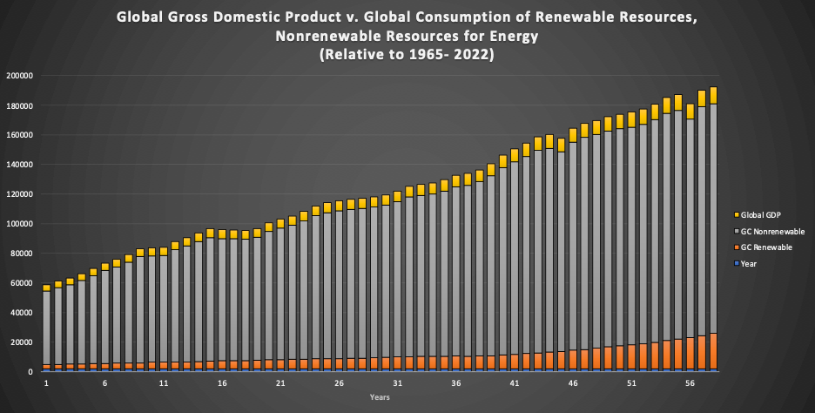
Figure I
The histogram of all variables is a left, or positively skewed histogram of our dataset, inclusive of GGDP (per capita), GCRR, GCNR, and year.
We can also see here how much more closely related patterns in levels of GGDP & nonrenewables are related in comparison to renewables.
There are zero outliers, allowing us to assume that there are no errors within the inputted data.
Notes:
Investments in clean energy must more than triple by 2030 to keep a goal of reaching net-zero emissions by 2050.
As though being a climate change hero is not enough, emerging fiscal and regulatory incentives including tax credits and exemptions, feed-in-tariff, interest rate cuts, standards in sustainability and green power programs, have become the catalysts of environmentally deserved change
Developing countries are attracting private investment via the lack the public funding that these nations have.
Though investors decisions are heavily weighted in seeing a return on investments, or their individual benefit and sustainability is not always cheap, as well as still lacking financial returns despite the increase in attention.

Slide 10
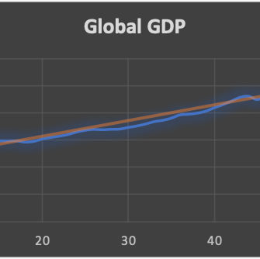
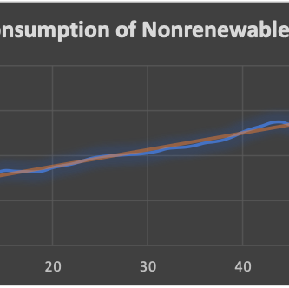
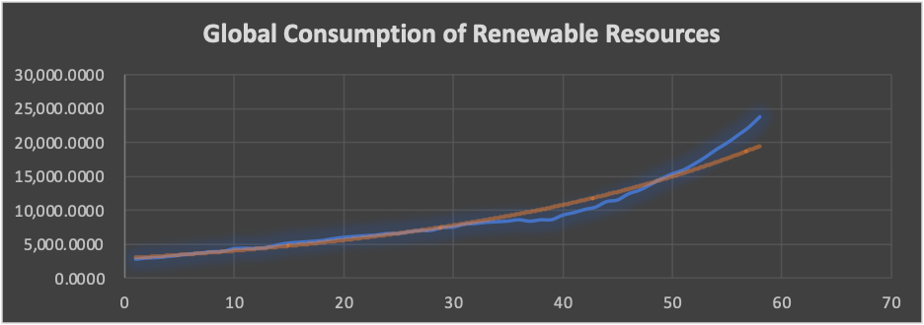
Figures II - IV
Sequence charts have been created for each variable, both independent and dependent, over the timespan of 58 years.
We can see here how closely related patterns in levels of GGDP & nonrenewables are in comparison to renewables.
We can observe that there is a positive or upward trend in all three variables when placed individually relative to Years.
Independent variables GGDP, GCRN, and GCNR are volatile; they have shown in the charts that they can be changed by an outside factor and do not create a repeated pattern.
Notes:
Investments in clean energy must more than triple by 2030 to keep a goal of reaching net-zero emissions by 2050.
As though being a climate change hero is not enough, emerging fiscal and regulatory incentives including tax credits and exemptions, feed-in-tariff, interest rate cuts, standards in sustainability and green power programs, have become the catalysts of environmentally deserved change
Developing countries are attracting private investment via the lack the public funding that these nations have.
Though investors decisions are heavily weighted in seeing a return on investments, or their individual benefit and sustainability is not always cheap, as well as still lacking financial returns despite the increase in attention.

Slide 11
Figure III In Comparison
It could be argued that the GCRN is exponential when looking at the trendline.
This could be due to the increased costs of nonrenewable resources for many geo-economic reasons or even recent innovations in the production of renewable energy resources in our energy-mix.
Our other variables analyzed in Figures 2 & 4 can be classified as linear, via their more confidently linear trendlines.
Notes:
Investments in clean energy must more than triple by 2030 to keep a goal of reaching net-zero emissions by 2050.
As though being a climate change hero is not enough, emerging fiscal and regulatory incentives including tax credits and exemptions, feed-in-tariff, interest rate cuts, standards in sustainability and green power programs, have become the catalysts of environmentally deserved change
Developing countries are attracting private investment via the lack the public funding that these nations have.
Though investors decisions are heavily weighted in seeing a return on investments, or their individual benefit and sustainability is not always cheap, as well as still lacking financial returns despite the increase in attention.

Slide 12
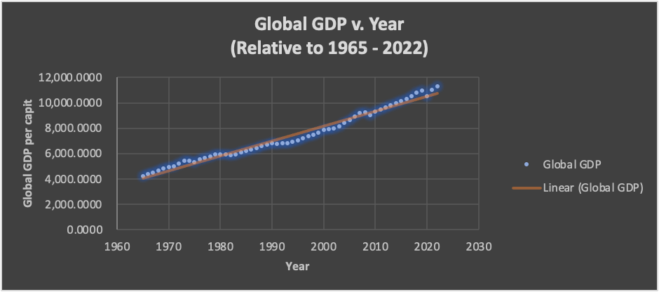
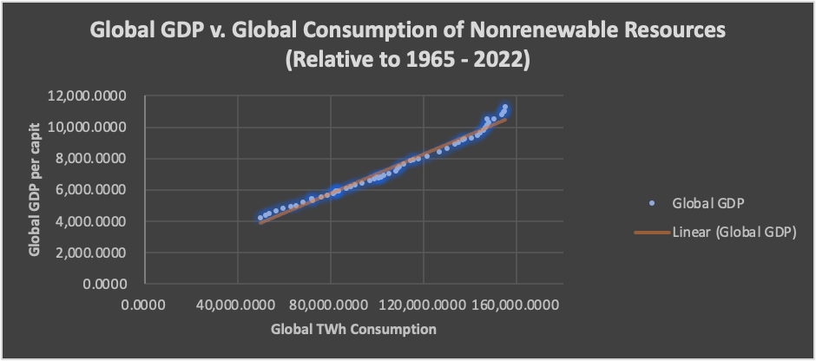
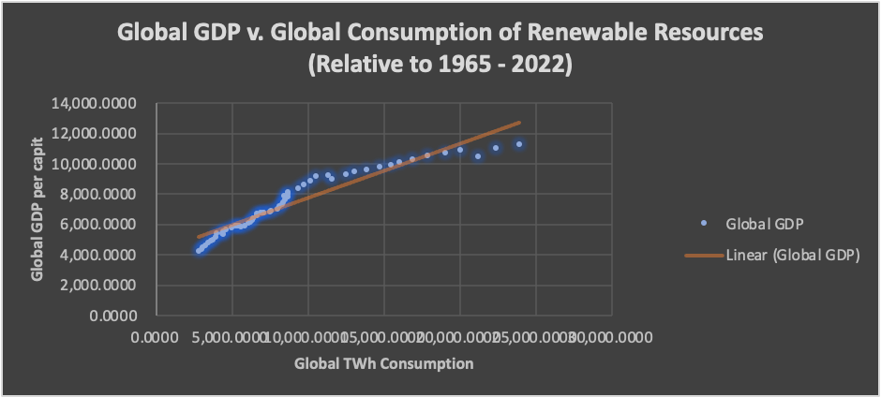
Figures V - VII
When the GCRN, GCNR, or Year variables are individually put relative to GGDP, the relationships are strong, positively correlated, and linear.
There are no outliers in the correlation, and it is not heteroscedastic dispersion.
All three variables have a homoscedastic or constant dispersion when correlated with GGDP.
The correlation is high or easily defined by the graphs.
GGDP is most correlated with GCNR and Year, supporting our original assumptions.
Notes:
Investments in clean energy must more than triple by 2030 to keep a goal of reaching net-zero emissions by 2050.
As though being a climate change hero is not enough, emerging fiscal and regulatory incentives including tax credits and exemptions, feed-in-tariff, interest rate cuts, standards in sustainability and green power programs, have become the catalysts of environmentally deserved change
Developing countries are attracting private investment via the lack the public funding that these nations have.
Though investors decisions are heavily weighted in seeing a return on investments, or their individual benefit and sustainability is not always cheap, as well as still lacking financial returns despite the increase in attention.

Slide 13
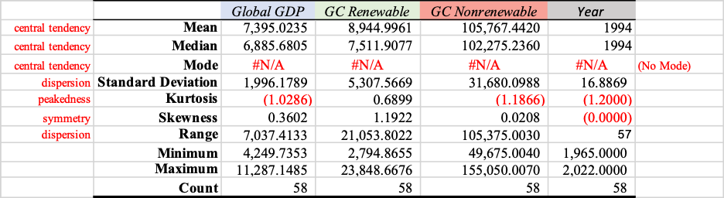
Descriptive Statistics
The variables used in this analysis are positively skewed; the mean is greater than the median for each variable (mode has been omitted in this model).
The skewness for each variable lies within the symmetrical skewness range (between -2 and 2), favored closely to one side of the bounds of symmetry (heavily tailed), like our other graphical analyses.
This is not alarming considering our hypothesis between GGDP and GCNR.
Skewness should be disregard in terms of Year, as it is equal to zero. This variable does play a role in the correlation between the variables in this analysis but does not play a role in how we analyze symmetry.
Notes:
Investments in clean energy must more than triple by 2030 to keep a goal of reaching net-zero emissions by 2050.
As though being a climate change hero is not enough, emerging fiscal and regulatory incentives including tax credits and exemptions, feed-in-tariff, interest rate cuts, standards in sustainability and green power programs, have become the catalysts of environmentally deserved change
Developing countries are attracting private investment via the lack the public funding that these nations have.
Though investors decisions are heavily weighted in seeing a return on investments, or their individual benefit and sustainability is not always cheap, as well as still lacking financial returns despite the increase in attention.

Slide 14

Descriptive Statistic Continued...
We can see that the kurtosis for GGDP, GCNR, and Years are negative. For similar reasons as the skewness measurement of GCRN, the kurtosis for GCRN is positive.
The measured kurtosis here is heavy-tailed.
The peakedness here is lower around the renewable resources than the nonrenewable.
We can see that the peak would be towards the right (kurtosis is greater in the correlation between GGDP, GCNR, and Years than that of GCRR).
Notes:
Investments in clean energy must more than triple by 2030 to keep a goal of reaching net-zero emissions by 2050.
As though being a climate change hero is not enough, emerging fiscal and regulatory incentives including tax credits and exemptions, feed-in-tariff, interest rate cuts, standards in sustainability and green power programs, have become the catalysts of environmentally deserved change
Developing countries are attracting private investment via the lack the public funding that these nations have.
Though investors decisions are heavily weighted in seeing a return on investments, or their individual benefit and sustainability is not always cheap, as well as still lacking financial returns despite the increase in attention.

Slide 15
Correlation Matrix Part I
The GGDP is highly correlated with all three independent variables but holds a higher correlation to nonrenewables, due to our current global energy-mix.
Global GDP is also closely (of high) correlation with the year the data was taken.
A number of outside indicators effecting the level of global GDP for that year, including but not limited to the market crash in 2008, the COVID-19 pandemic, or other past causes of global economic shock.
 | Global GDP | GC Renewable | GC Nonrenewable | Year
Global GDP | 1
GC Renewable | 0.956 | 1
GC Nonrenewable | 0.991 | 0.914 | 1
Year | 0.988 | 0.922 | 0.995 | 1
Notes:
Investments in clean energy must more than triple by 2030 to keep a goal of reaching net-zero emissions by 2050.
As though being a climate change hero is not enough, emerging fiscal and regulatory incentives including tax credits and exemptions, feed-in-tariff, interest rate cuts, standards in sustainability and green power programs, have become the catalysts of environmentally deserved change
Developing countries are attracting private investment via the lack the public funding that these nations have.
Though investors decisions are heavily weighted in seeing a return on investments, or their individual benefit and sustainability is not always cheap, as well as still lacking financial returns despite the increase in attention.

Slide 16
Correlation Matrix Part II
These correlations agree with the original assumption that global GDP has a reliance on global energy consumption, and most directly correlated with GCNR and Years.
This matrix further proves that the current global energy-mix dependance (weighted in nonrenewable resources) weighs most on global GDP (at 0.991), more than outside contributors that could be included in the year the data was taken, as well as (the less common usage of) renewable resources.
The regression correlation coefficient for GDP v. Year (at 0.988) also suggests high association, as this is a close number to the most correlated relationship.
The dependent variable (global GDP) having multiple association between individual independent variables gives evidence of multicollinearity, as the increase of consumption of energy can also be a result of GGDP, and vice versa.
Notes:
Investments in clean energy must more than triple by 2030 to keep a goal of reaching net-zero emissions by 2050.
As though being a climate change hero is not enough, emerging fiscal and regulatory incentives including tax credits and exemptions, feed-in-tariff, interest rate cuts, standards in sustainability and green power programs, have become the catalysts of environmentally deserved change
Developing countries are attracting private investment via the lack the public funding that these nations have.
Though investors decisions are heavily weighted in seeing a return on investments, or their individual benefit and sustainability is not always cheap, as well as still lacking financial returns despite the increase in attention.

Slide 17

Regression Equation
Equation for Sample Regression Line.
Eqn. 4 GGDP = 44,069.31 + 0.12GCRR + 0.06GCNR - 21.9Years
t-stat (2.59)** (17.74)*** (12.47)* (-2.49)
p-value (.01) (.0) (.0) (.01)
r (corr) (.12) (.06) (-21.89)
n = 58 r-sq. = .997 F = 6,946.44*** F-Prob = .000 SE = 104.26
Confidence Intervals.
*Significant at the 10% level of significance (90% Sure, or “are below”)
**Significant at the 5% level of significance (95% Sure, or “are below”)
***Significant at the 1% level of significance (99% Sure, or “are below”)
Results of an F-test for the entire model.
Ho: bgcrn = bgcnr = byear = 0 (Null)
Ha: at least 1 bi not equal to 0 (6,946.44 > 4.99) (Alternate)
Notes:
Investments in clean energy must more than triple by 2030 to keep a goal of reaching net-zero emissions by 2050.
As though being a climate change hero is not enough, emerging fiscal and regulatory incentives including tax credits and exemptions, feed-in-tariff, interest rate cuts, standards in sustainability and green power programs, have become the catalysts of environmentally deserved change
Developing countries are attracting private investment via the lack the public funding that these nations have.
Though investors decisions are heavily weighted in seeing a return on investments, or their individual benefit and sustainability is not always cheap, as well as still lacking financial returns despite the increase in attention.

Slide 18
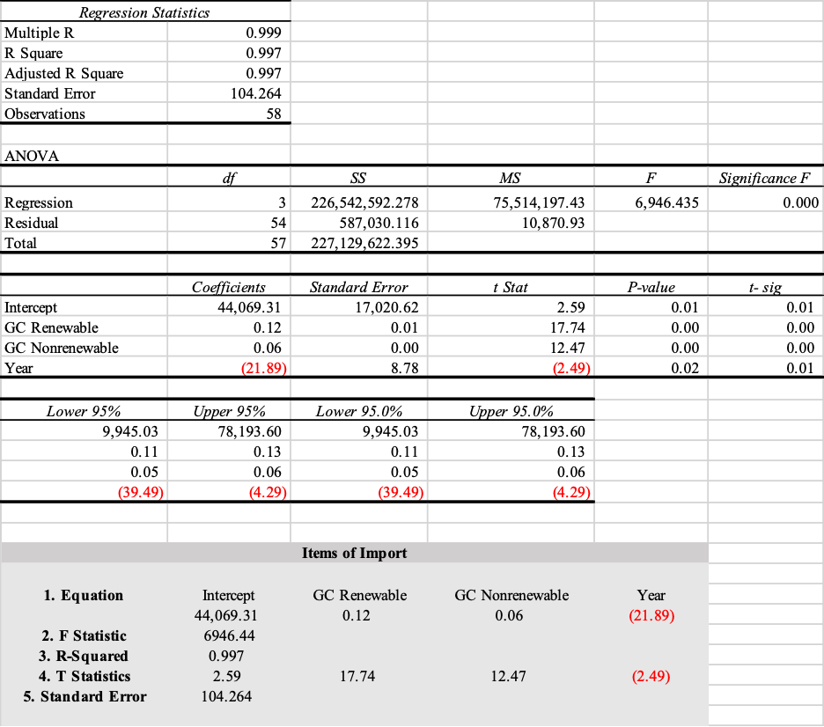
Regression Results Part I
The standard deviation is notably less than the mean for each variable and it can be concluded that the data is closely dispersed around the mean data or exhibits low dispersion.
For this model we will accept the null hypothesis and reject the alternative hypothesis, as the F Significance is equal to 0.000.
We can assume that being the p-values are above the F-sig, that the model does not efficiently prove that it is more correlated when analyzed next to the independent variables (this model) than if it weren’t.
The P-Value is less than 0.05 for all variables and proves this model to be significant.
Notes:
Investments in clean energy must more than triple by 2030 to keep a goal of reaching net-zero emissions by 2050.
As though being a climate change hero is not enough, emerging fiscal and regulatory incentives including tax credits and exemptions, feed-in-tariff, interest rate cuts, standards in sustainability and green power programs, have become the catalysts of environmentally deserved change
Developing countries are attracting private investment via the lack the public funding that these nations have.
Though investors decisions are heavily weighted in seeing a return on investments, or their individual benefit and sustainability is not always cheap, as well as still lacking financial returns despite the increase in attention.

Slide 19
Regression Results Part II
When looking at the results for our coefficient of determination (R-Squared, equal to 0.997 or 99.7%) we can conclude that...
The statistical model predicts the suggested outcome or assumption that the association between the dependent and independent variables is very strong
There is little variation between the independent variables.
The Standard Error values of our independent variables tell us that the GCRR (0.01) and GCNR (0.00) do not fall far from the regression line and support the accuracy of our original assumptions relative to GGDP.
The greater Standard Error value seen in the Year variable also supports the idea that there are outside independent variables dependent on the Year variable.
Notes:
Investments in clean energy must more than triple by 2030 to keep a goal of reaching net-zero emissions by 2050.
As though being a climate change hero is not enough, emerging fiscal and regulatory incentives including tax credits and exemptions, feed-in-tariff, interest rate cuts, standards in sustainability and green power programs, have become the catalysts of environmentally deserved change
Developing countries are attracting private investment via the lack the public funding that these nations have.
Though investors decisions are heavily weighted in seeing a return on investments, or their individual benefit and sustainability is not always cheap, as well as still lacking financial returns despite the increase in attention.

Slide 20

Conclusions Part I
The research presented here can be considered successful.
The coefficient of determination (R2) tells us that 99.7% of variation in the levels of GGDP by year (relative to 1965 to 2022) can be associated with the variation in amount of TWh consumption of both GCRR and GCNR by year, as well as by the year the data was taken from alone.
All independent variables were predictive, though less predictive in the years variable.
The initial assumption can be considered true.
Notes:
Investments in clean energy must more than triple by 2030 to keep a goal of reaching net-zero emissions by 2050.
As though being a climate change hero is not enough, emerging fiscal and regulatory incentives including tax credits and exemptions, feed-in-tariff, interest rate cuts, standards in sustainability and green power programs, have become the catalysts of environmentally deserved change
Developing countries are attracting private investment via the lack the public funding that these nations have.
Though investors decisions are heavily weighted in seeing a return on investments, or their individual benefit and sustainability is not always cheap, as well as still lacking financial returns despite the increase in attention.

Slide 21
Room for Error
This data can be improved in terms of time accuracy. The dates measuring the Global TWh consumption are determined per year but not on the same date of each year like the data used measuring Global GDP.
Another way this dataset could be altered to improve this analysis is by also calculating the energy used to produce the energy consumed in our question for all resources and not just fossil fuels.
Notes:
Investments in clean energy must more than triple by 2030 to keep a goal of reaching net-zero emissions by 2050.
As though being a climate change hero is not enough, emerging fiscal and regulatory incentives including tax credits and exemptions, feed-in-tariff, interest rate cuts, standards in sustainability and green power programs, have become the catalysts of environmentally deserved change
Developing countries are attracting private investment via the lack the public funding that these nations have.
Though investors decisions are heavily weighted in seeing a return on investments, or their individual benefit and sustainability is not always cheap, as well as still lacking financial returns despite the increase in attention.

Slide 22
Where Global Politics Come-In
Energy scarcity has obviously put an immense strain on the global energy demand as well as on nations to provide their people and firms with power to drive economic success.
There are less-developed economies that are lacking in quality of life due to lack of access to energy or lack of production of energy in their countries.
Efforts are restricted by the inevitable conflicting environmental and financial compromises that come along with the implementation of these cleaner means of energy production.
Notes:
Both firms and consumers play a role in the cycle of tendencies to ignore the environmental impact of business decisions and the strength of purchasing power.
Corporations or larger firms hold the most wealth in the economy and thus hold more power, though are of course still highly influenced by their consumers.
The pressure on corporations to prioritize reducing GHG emissions in their activities from investors, intergovernmental groups, policy makers and the new leaders of industries is on the rise.
Corporate Social Responsibility has quickly grown to curb effects of climate change by appeasing changes in consumer ideas towards sustainable living and ethical justice.

Slide 23

Global Public Policy Implications
Energy efficiency policies and programs such as investment incentives and tax benefits encourage projects that...
Contribute less to global anthropogenic emissions by reducing or offsetting energy usage of high CO2 emission levels.
Increase financial benefits for corporations and governments to invest in climate change reversal.
Raise the standards of corporate social responsibility and the perspective of consumer ideas within their markets.
Notes:
Both firms and consumers play a role in the cycle of tendencies to ignore the environmental impact of business decisions and the strength of purchasing power.
Corporations or larger firms hold the most wealth in the economy and thus hold more power, though are of course still highly influenced by their consumers.
The pressure on corporations to prioritize reducing GHG emissions in their activities from investors, intergovernmental groups, policy makers and the new leaders of industries is on the rise.
Corporate Social Responsibility has quickly grown to curb effects of climate change by appeasing changes in consumer ideas towards sustainable living and ethical justice.

Slide 24
Thank you!
Notes:
I’m not sure how much time we have but

